Slide 1





Version Control Systems
Git and GitHub
SoftUni Team
Technical Trainers
Software University
http://softuni.bg

Slide 2

Table of Contents
Software Configuration Management (SCM)
Git
GitHub

Slide 3
Have a Question?
sli.do #fund-softuni

Slide 4
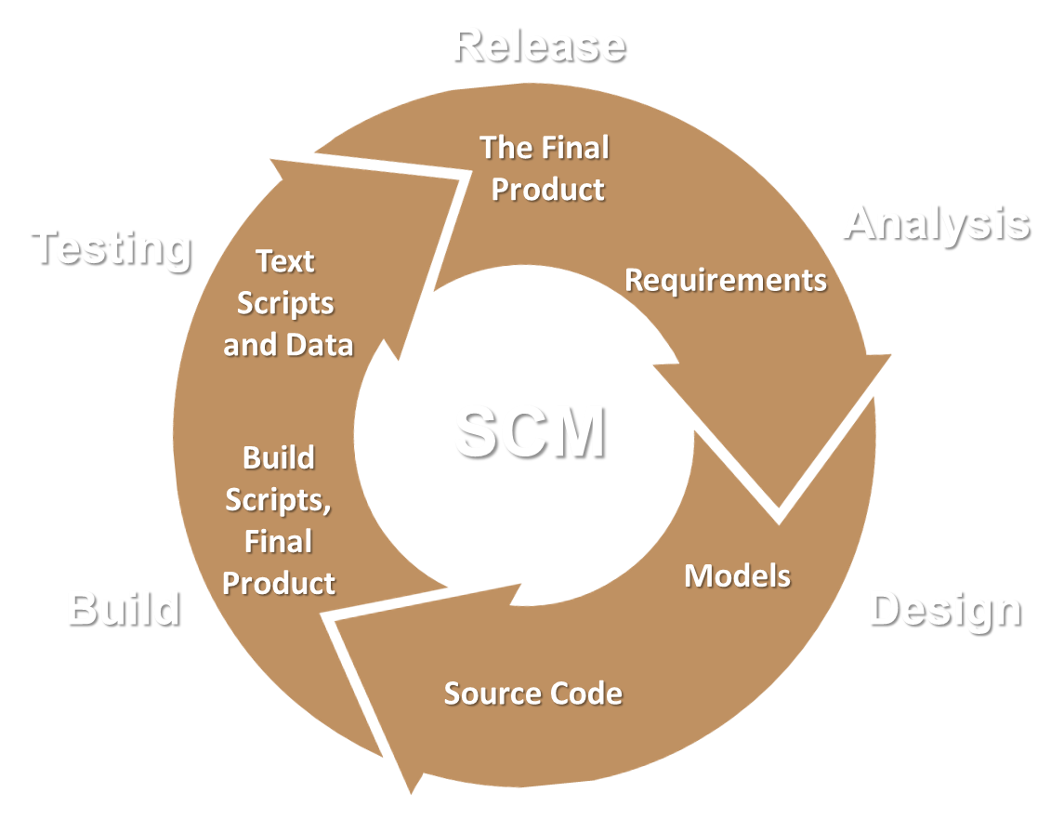
Software Configuration Management

Slide 5
Software Configuration Management (SCM)
Version Control ≈ Software Configuration Management (SCM)
A software engineering discipline
Consists of techniques, practices and tools for working on shared source code and files
Mechanisms for management, control and tracking the changes
Defines the process of change management
Keeps track of what is happening in the project over the time
Solves conflicts in the changes

Slide 6
SCM and the Software Development Lifecycle
Release
The Final
Product
Analysis
Testing
Text
Scripts
and Data
Requirements
SCM
Build
Scripts,
Final
Product
Models
Build
Design
Source Code
Implementation

Slide 7
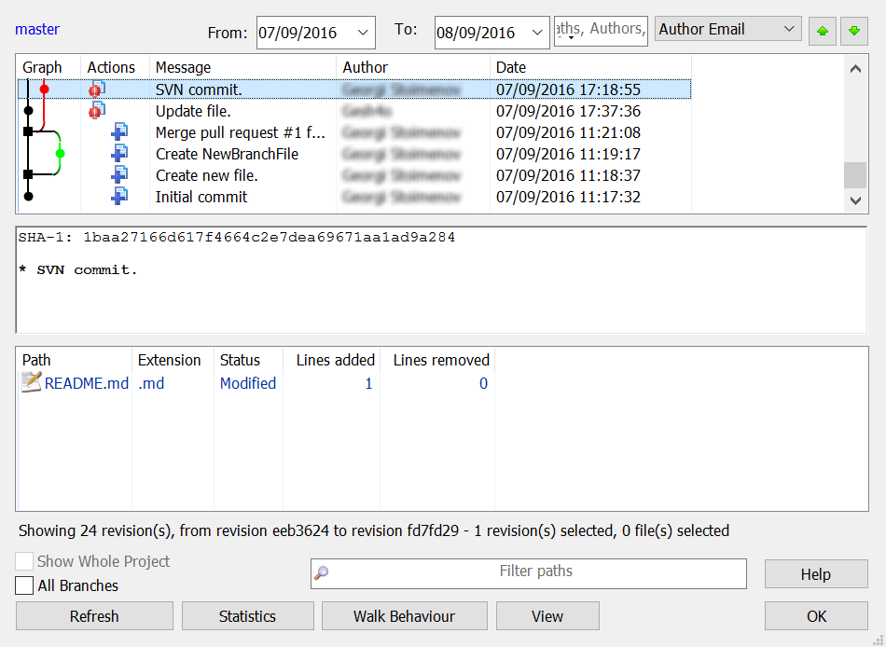
Change Log
Systems for version control keep a complete change log (history)
Who?
Why?
When?

Slide 8


Change Log (2)
Old versions are saved in the change log
Can be retrieved, examined and even reverted
Revert
Good version
Bad version

Slide 9


Vocabulary: Repository
Remote
Local

Slide 10
Vocabulary: Clone
Clone
Remote
Local

Slide 11
Vocabulary: Commit
Commit

Slide 12


Vocabulary: Sync
Fetch
Upload
Conflict

Slide 13
Vocabulary: Branch
master
master
custom-branch

Slide 14
Vocabulary: Merge branches
Conflict
master
master
custom-branch

Slide 15





Еxample: Branches

Slide 16

Git

Slide 17

What is Git?
Distributed source-control system
Work with local and remote repositories
Git bash – command line interface for Git
Free, open-source
Has Windows version (msysGit)
http://msysgit.github.io
https://www.atlassian.com/git/tutorials/setting-up-a-repository

Slide 18
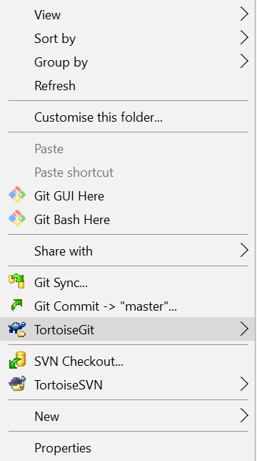
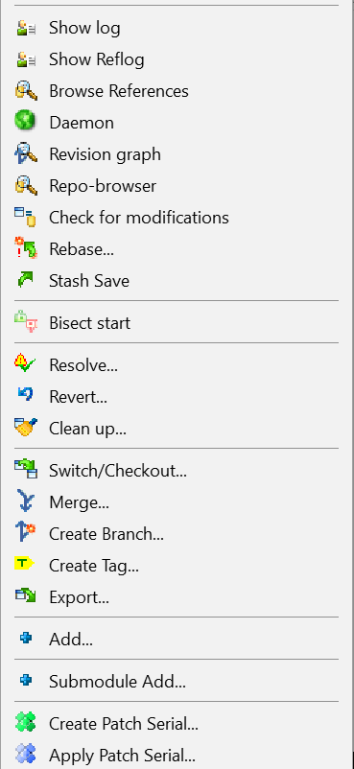
Using Git
Runs on Linux, Windows, Mac OS
Console client
GitBash
GUI client – TortoiseGit
https://tortoisegit.org/download/
Visual Studio / Eclipse plug-ins

Slide 19

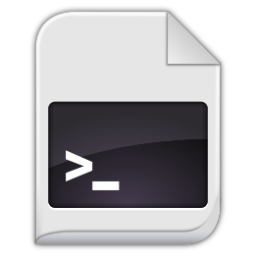
How It Works?
Pull
git add
Modified
Staged
Commited

Slide 20
How It Works?
Push
git commit
Modified
Staged
Commited

Slide 21
Installing Git
msysGit Installation on Windows
Download Git for Windows from: http://msysgit.github.io
“Next, Next, Next” does the trick
Options to select (they should be selected by default)
“Use Git Bash only”
“Checkout Windows-style, commit Unix-style endings”
Git installation on Linux:
sudo apt-get install git

Slide 22
Basic Git Commands
Cloning an existing Git repository
Fetch and merge the latest changes from the remote repository
Preparing (adding / selecting) files for a commit
Committing to the local repository
git clone [remote url]
git pull
git add [filename] ("git add ." adds everything)
git commit –m "[your message here]"

Slide 23
Basic Git Commands (2)
Check the status of your local repository (see the local changes)
Creating a new local repository (in the current directory)
Creating a remote (assign a short name for remote Git URL)
Pushing to a remote (send changes to the remote repository)
git status
git init
git remote add [remote name] [remote url]
git push [remote name] [local name]

Slide 24
Using GitBash: Example
mkdir work
cd work
git clone https://github.com/SoftUni/test.git
dir
cd test
dir
git status
(edit some file)
git status
git add .
git commit -m "changes"
git push

Slide 25
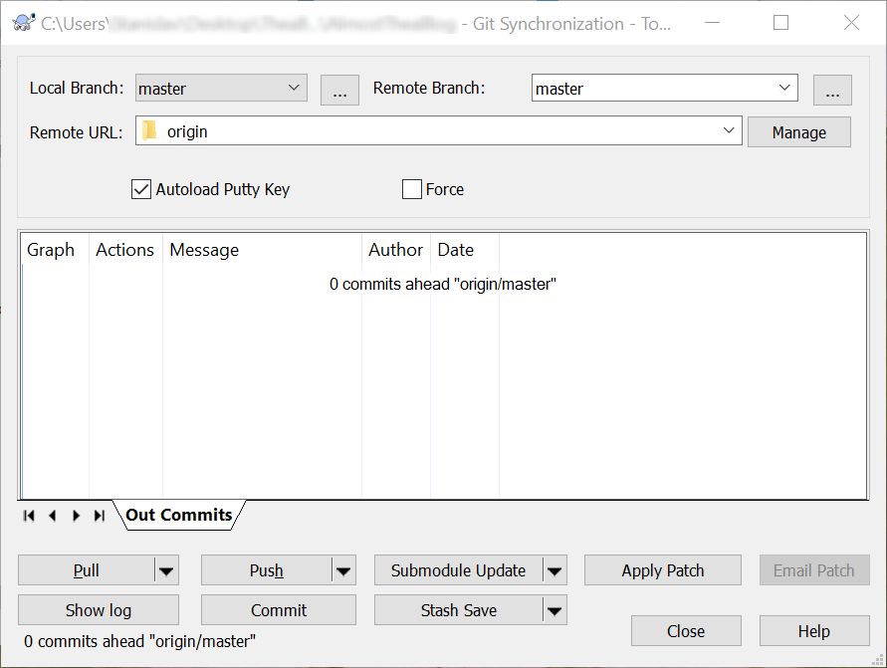
Using TortoiseGit: Example

Slide 26

GitHub
The Social Network for Developers

Slide 27
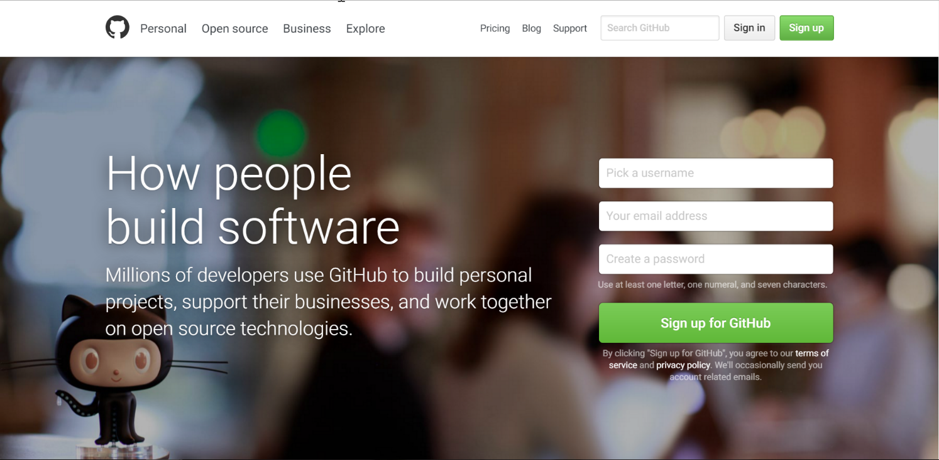
What is GitHub?
GitHub is the world's #1 source code hosting site
Free for open-source projects
Paid plans for private projects

Slide 28
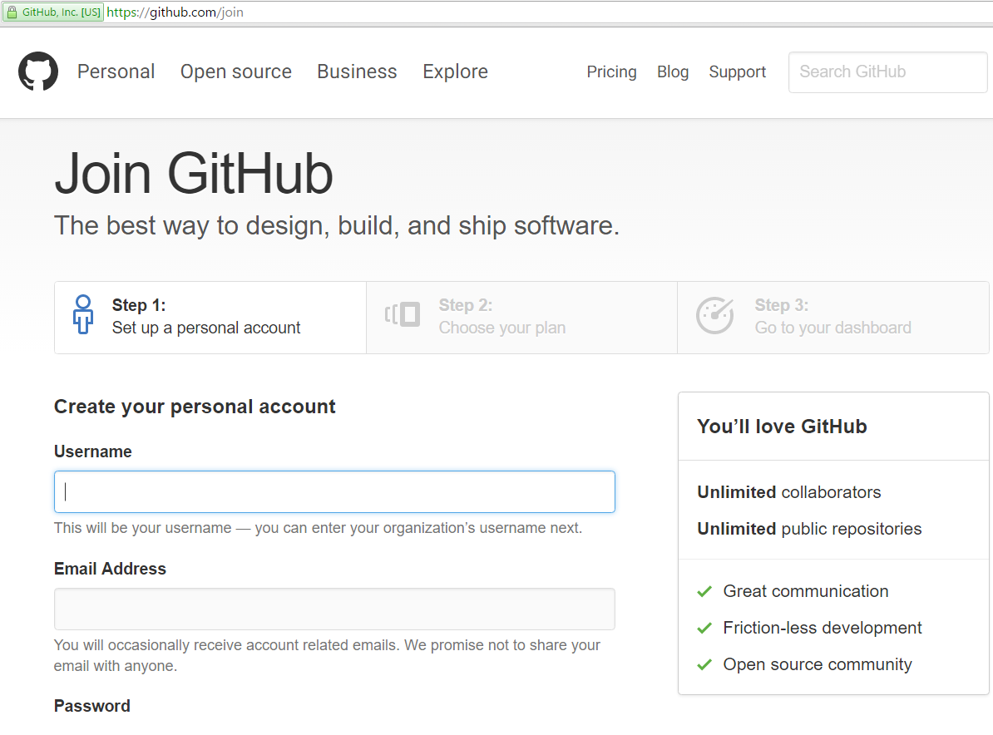
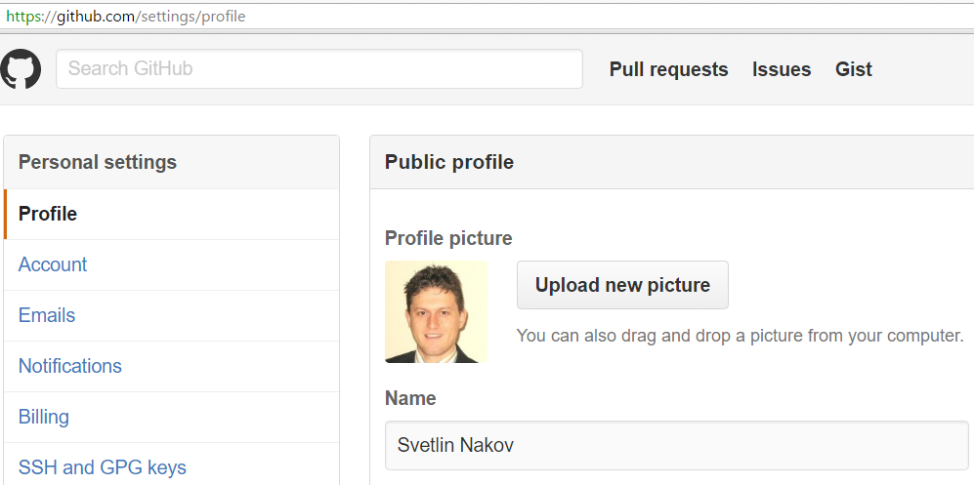
Exercise: Create Your Own Profile at GitHub

Slide 29

GitHub
Live Exercises in Class (Lab)

Slide 30

Summary
Use version control systems to work in a team or for big projects.
We can revert to previous version (state) of our project.
There are several commands for manipulating the version control system
GitHub is the most popular hosting platform

Slide 31









Version Control Systems
https://softuni.bg/courses/programming-fundamentals/

Slide 32
License
This course (slides, examples, demos, videos, homework, etc.) is licensed under the "Creative Commons Attribution-NonCommercial-ShareAlike 4.0 International" license
Attribution: this work may contain portions from
"Fundamentals of Computer Programming with C#" book by Svetlin Nakov & Co. under CC-BY-SA license

Slide 33






Free Trainings @ Software University
Software University Foundation – softuni.org
Software University – High-Quality Education, Profession and Job for Software Developers
softuni.bg
Software University @ Facebook
facebook.com/SoftwareUniversity
Software University @ YouTube
youtube.com/SoftwareUniversity
Software University Forums – forum.softuni.bg

